Slide 1
Graph Traversal

Slide 2
Graph Traversal
Graph traversal is a technique used for a searching vertex in a graph. The graph traversal is also used to decide the order of vertices is visited in the search process. A graph traversal finds the edges to be used in the search process without creating loops. That means using graph traversal we visit all the vertices of the graph without getting into looping path. There are two graph traversal techniques and they are as follows...
DFS (Depth First Search)
BFS (Breadth First Search)

Slide 3
Breadth first search
Traversal means visiting all the nodes of a graph. Breadth First Traversal or Depth First Search is a recursive algorithm for searching all the vertices of a graph or tree data structure.
BFS stands for Breadth First Search. It is also known as level order traversal. The Queue data structure is used for the Breadth First Search traversal. When we use the BFS algorithm for the traversal in a graph, we can consider any node as a root node.

Slide 4
BFS (Breadth First Search)
We use the following steps to implement BFS traversal...
Step 1 - Define a Queue of size total number of vertices in the graph.
Step 2 - Select any vertex as starting point for traversal. Visit that vertex and insert it into the Queue.
Step 3 - Visit all the non-visited adjacent vertices of the vertex which is at front of the Queue and insert them into the Queue.
Step 4 - When there is no new vertex to be visited from the vertex which is at front of the Queue then delete that vertex.
Step 5 - Repeat steps 3 and 4 until queue becomes empty.
Step 6 - When queue becomes empty, then produce final spanning tree by removing unused edges from the graph

Slide 5
A standard BFS implementation puts each vertex of the graph into one of two categories:
Visited
Not Visited
The purpose of the algorithm is to mark each vertex as visited while avoiding cycles.
The algorithm works as follows:
Start by putting any one of the graph's vertices at the back of a queue.
Take the front item of the queue and add it to the visited list.
Create a list of that vertex's adjacent nodes. Add the ones which aren't in the visited list to the back of the queue.
Keep repeating steps 2 and 3 until the queue is empty.

Slide 6
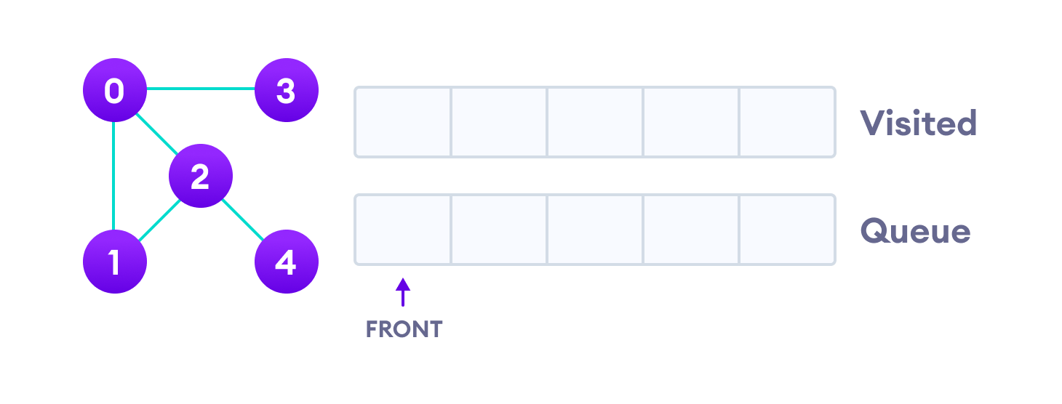
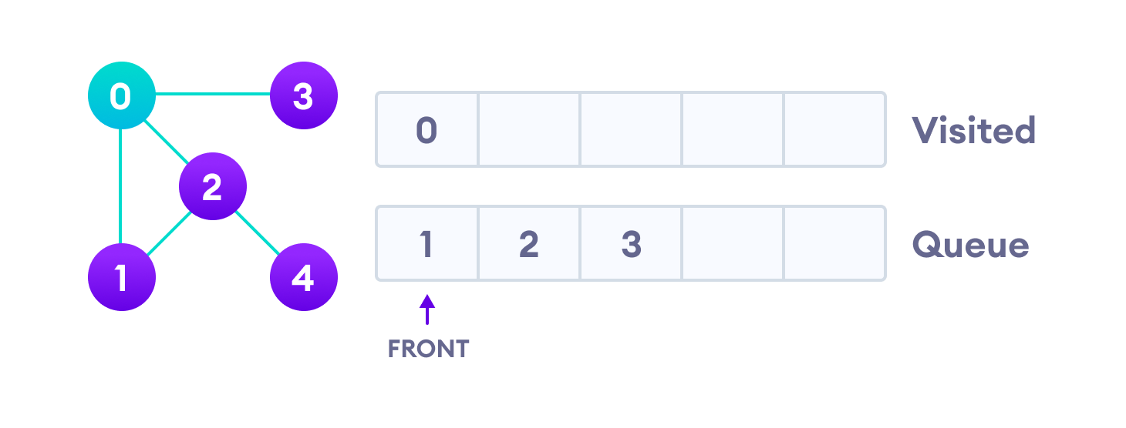

Slide 7
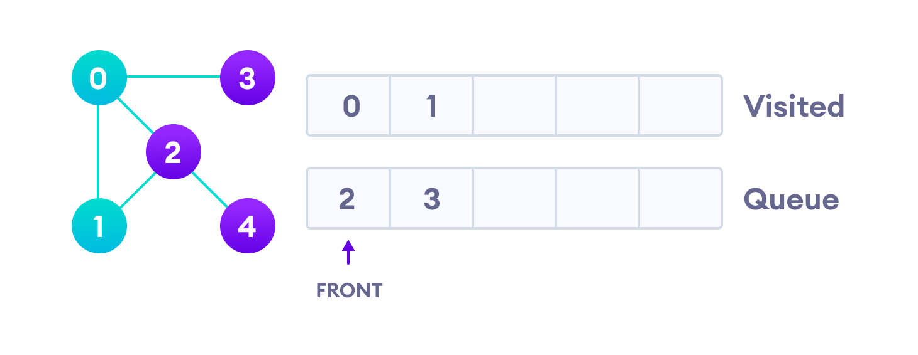
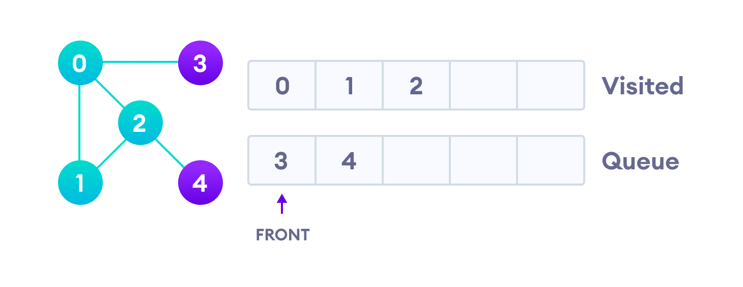

Slide 8
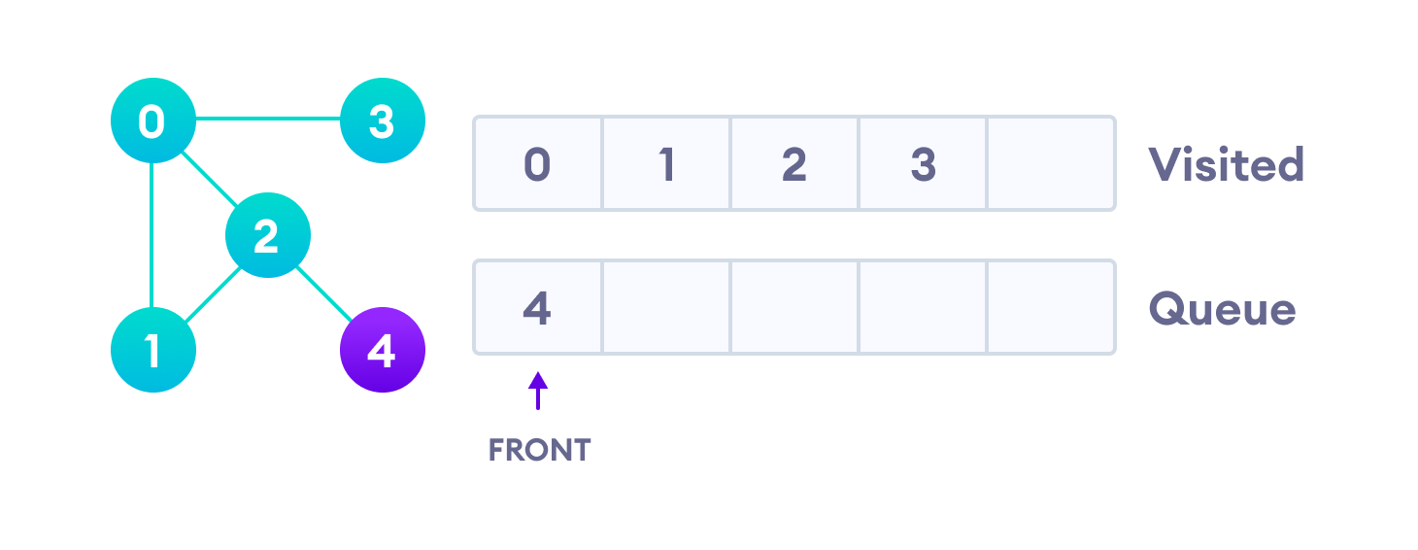
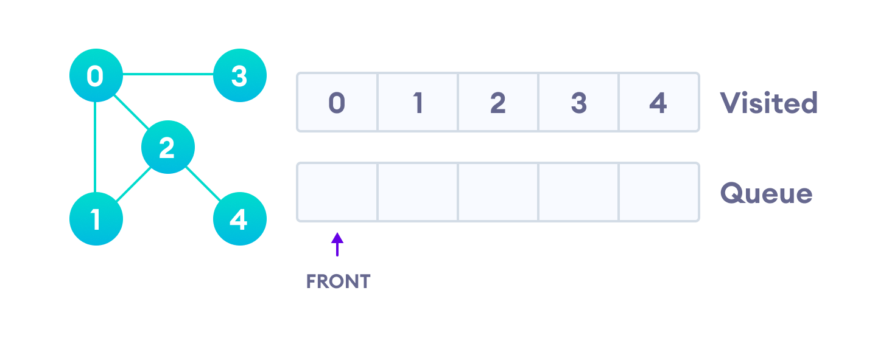

Slide 9
The time complexity of the BFS algorithm is represented in the form of O(V + E), where V is the number of nodes and E is the number of edges.
The space complexity of the algorithm is O(V).

Slide 10
BFS Algorithm Applications
To build index by search index
For GPS navigation
Path finding algorithms
In Ford-Fulkerson algorithm to find maximum flow in a network
Cycle detection in an undirected graph
In minimum spanning tree

Slide 11
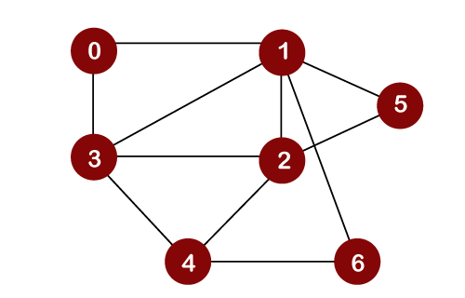
Ex. - BFS

Slide 12
Depth First Search or DFS for a Graph
It is a recursive algorithm to search all the vertices of a tree data structure or a graph. The depth-first search (DFS) algorithm starts with the initial node of graph G and goes deeper until we find the goal node or the node with no children.
Because of the recursive nature, stack data structure can be used to implement the DFS algorithm. The process of implementing the DFS is similar to the BFS algorithm.

Slide 13
How DFS process?
The step by step process to implement the DFS traversal is given as follows -
First, create a stack with the total number of vertices in the graph.
Now, choose any vertex as the starting point of traversal, and push that vertex into the stack.
After that, push a non-visited vertex (adjacent to the vertex on the top of the stack) to the top of the stack.
Now, repeat steps 3 and 4 until no vertices are left to visit from the vertex on the stack's top.
If no vertex is left, go back and pop a vertex from the stack.
Repeat steps 2, 3, and 4 until the stack is empty.

Slide 14
Applications of DFS algorithm
DFS algorithm can be used to implement the topological sorting.
It can be used to find the paths between two vertices.
It can also be used to detect cycles in the graph.
DFS algorithm is also used for one solution puzzles.
DFS is used to determine if a graph is bipartite or not.

Slide 15
DFS (Depth First Search)
We use the following steps to implement DFS traversal...
Step 1 - Define a Stack of size total number of vertices in the graph.
Step 2 - Select any vertex as starting point for traversal. Visit that vertex and push it on to the Stack.
Step 3 - Visit any one of the non-visited adjacent vertices of a vertex which is at the top of stack and push it on to the stack.
Step 4 - Repeat step 3 until there is no new vertex to be visited from the vertex which is at the top of the stack.
Step 5 - When there is no new vertex to visit then use back tracking and pop one vertex from the stack.
Step 6 - Repeat steps 3, 4 and 5 until stack becomes Empty.
Step 7 - When stack becomes Empty, then produce final spanning tree by removing unused edges from the graph

Slide 16
Pseudocode
DFS(G,v) ( v is the vertex where the search starts )
Stack S := {}; ( start with an empty stack )
for each vertex u, set visited[u] := false;
push S, v;
while (S is not empty) do
u := pop S;
if (not visited[u]) then
visited[u] := true;
for each unvisited neighbour w of u
push S, w;
end if
end while
END DFS()

Slide 17
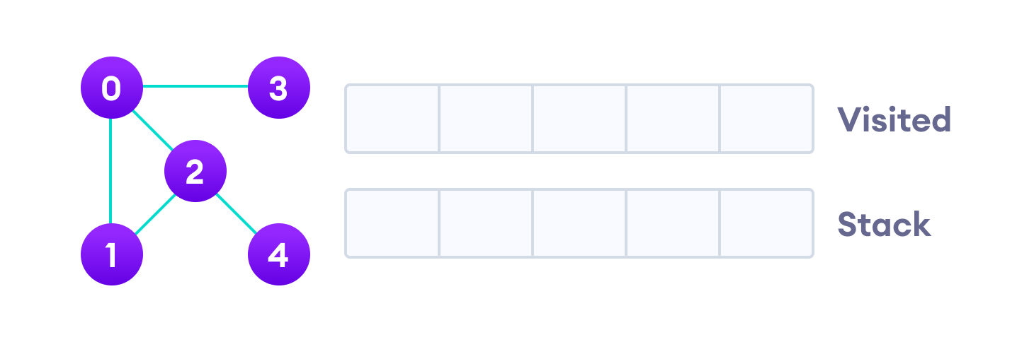

Slide 18
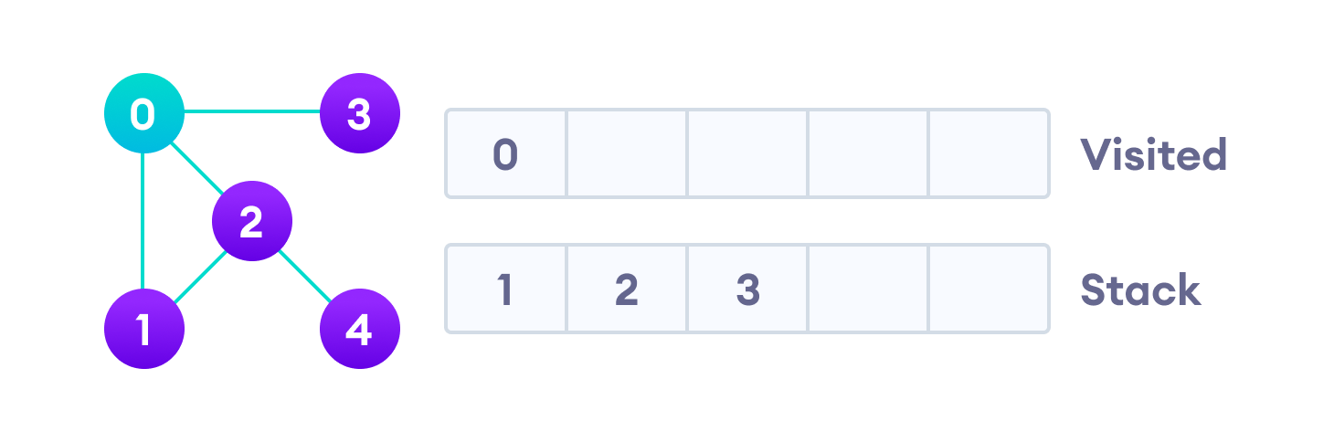
We start from vertex 0, the DFS algorithm starts by putting it in the Visited list and
putting all its adjacent vertices in the stack.
visit the element and put it in the visited list

Slide 19
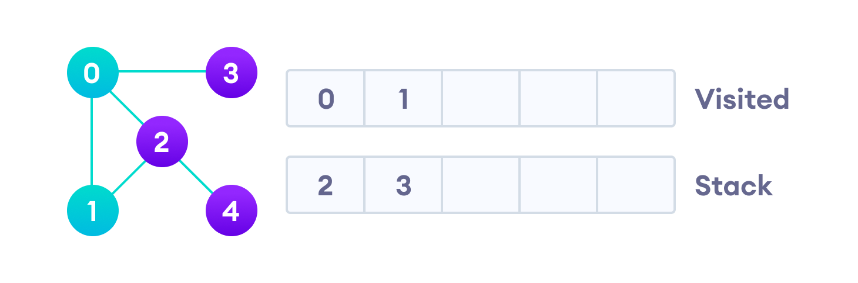
Next, we visit the element at the top of stack i.e. 1 and go to its adjacent nodes.
Since 0 has already been visited, we visit 2 instead.
Visit the element at the top of stack

Slide 20
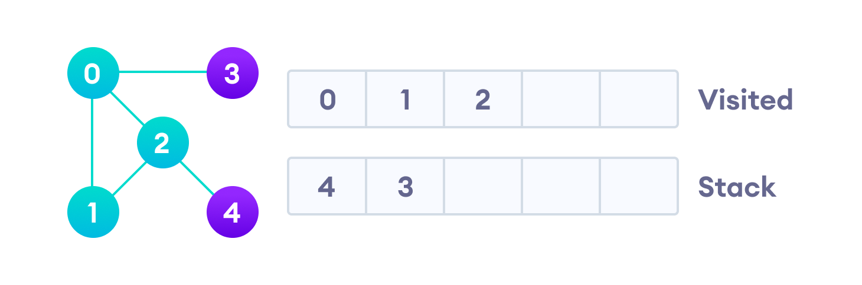
Vertex 2 has an unvisited adjacent vertex in 4, so we add that to the top of the stack and visit it.
Vertex 2 has an unvisited adjacent vertex in 4, so we add that to the top of the stack and visit it.

Slide 21
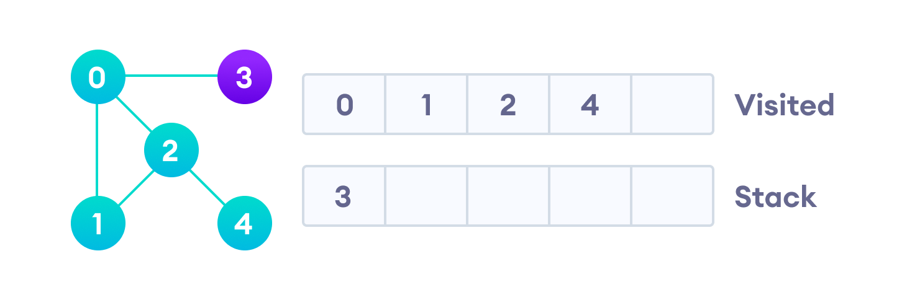
Vertex 2 has an unvisited adjacent vertex in 4, so we add that to the top of the stack
and visit it.

Slide 22
Vertex 2 has an unvisited adjacent vertex in 4, so we add that to the top of the stack and visit it.

Slide 23
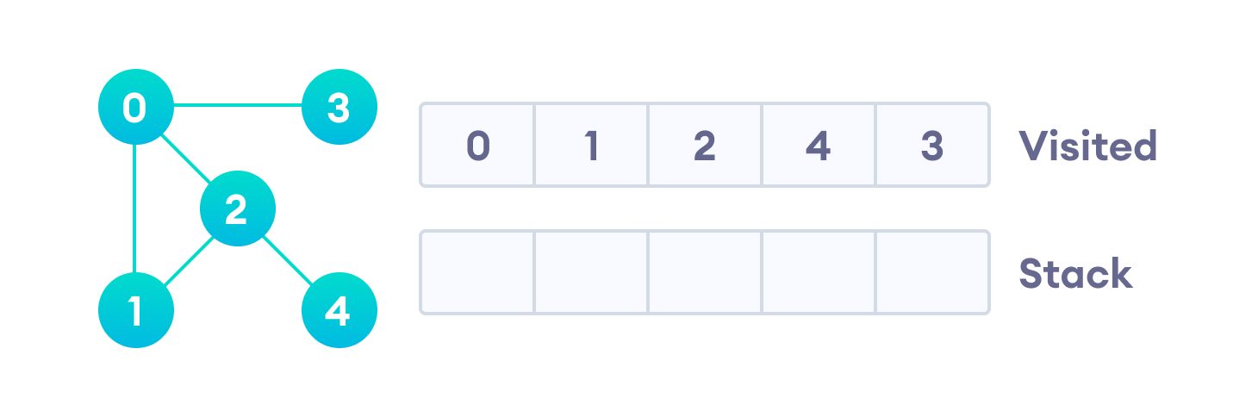
After we visit the last element 3, it doesn't have any unvisited adjacent nodes,
so we have completed the Depth First Traversal of the graph.

